Slide 1
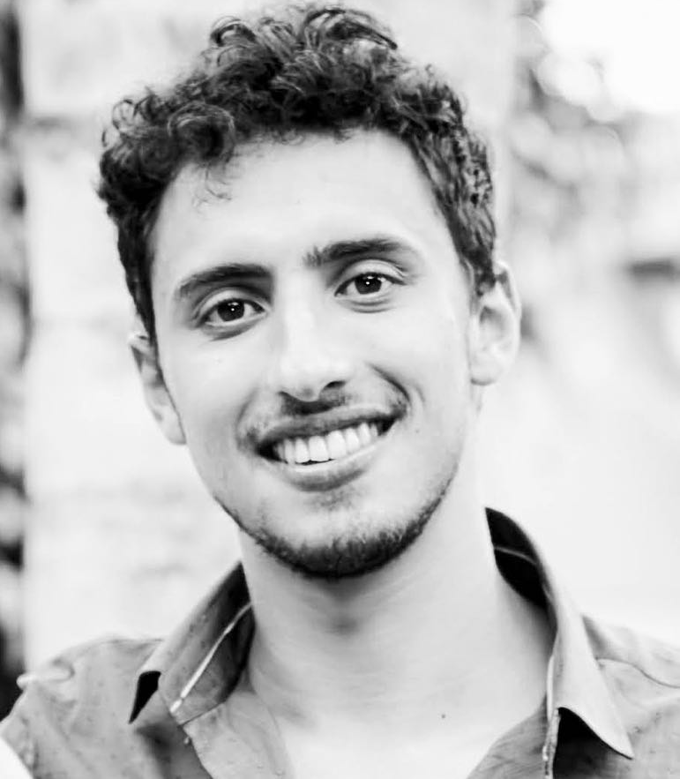
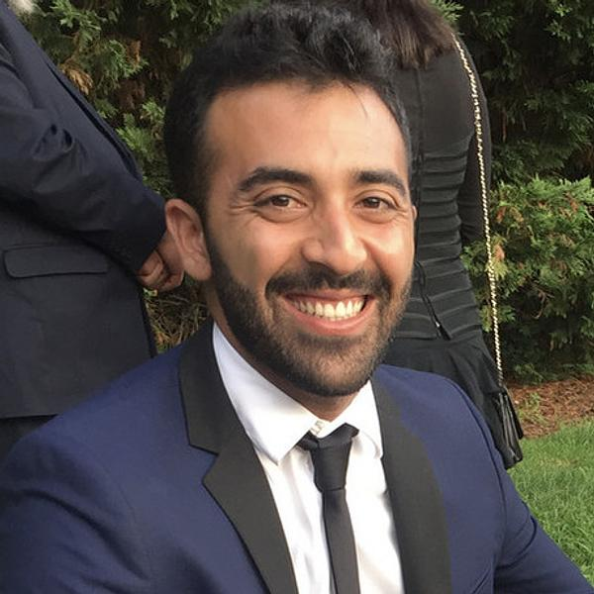
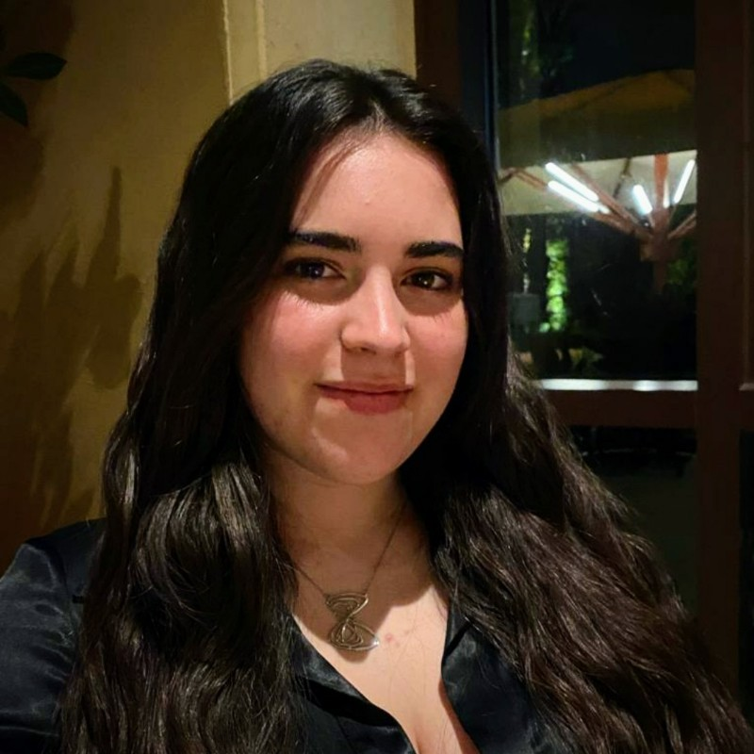
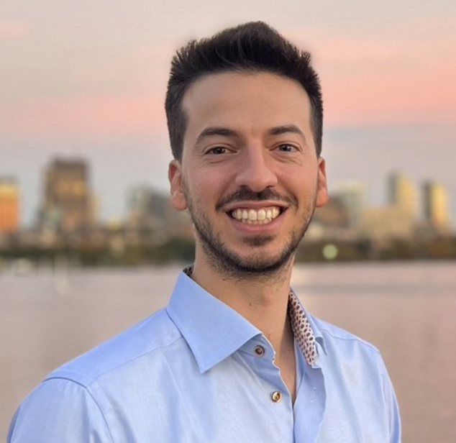
JellyByte
Rare Diseases Pathway Exploration Framework
Ilan Mitnikov
David Magrefty
Liyam Chitayat
Itamar Chinn
MIT Grad Student
Molecular Machines Group
MIT Grad Student
Andrew Lo Lab
MIT Grad Student
Ed Boyden Lab
MIT Grad Student
Barzilay Lab

Slide 2
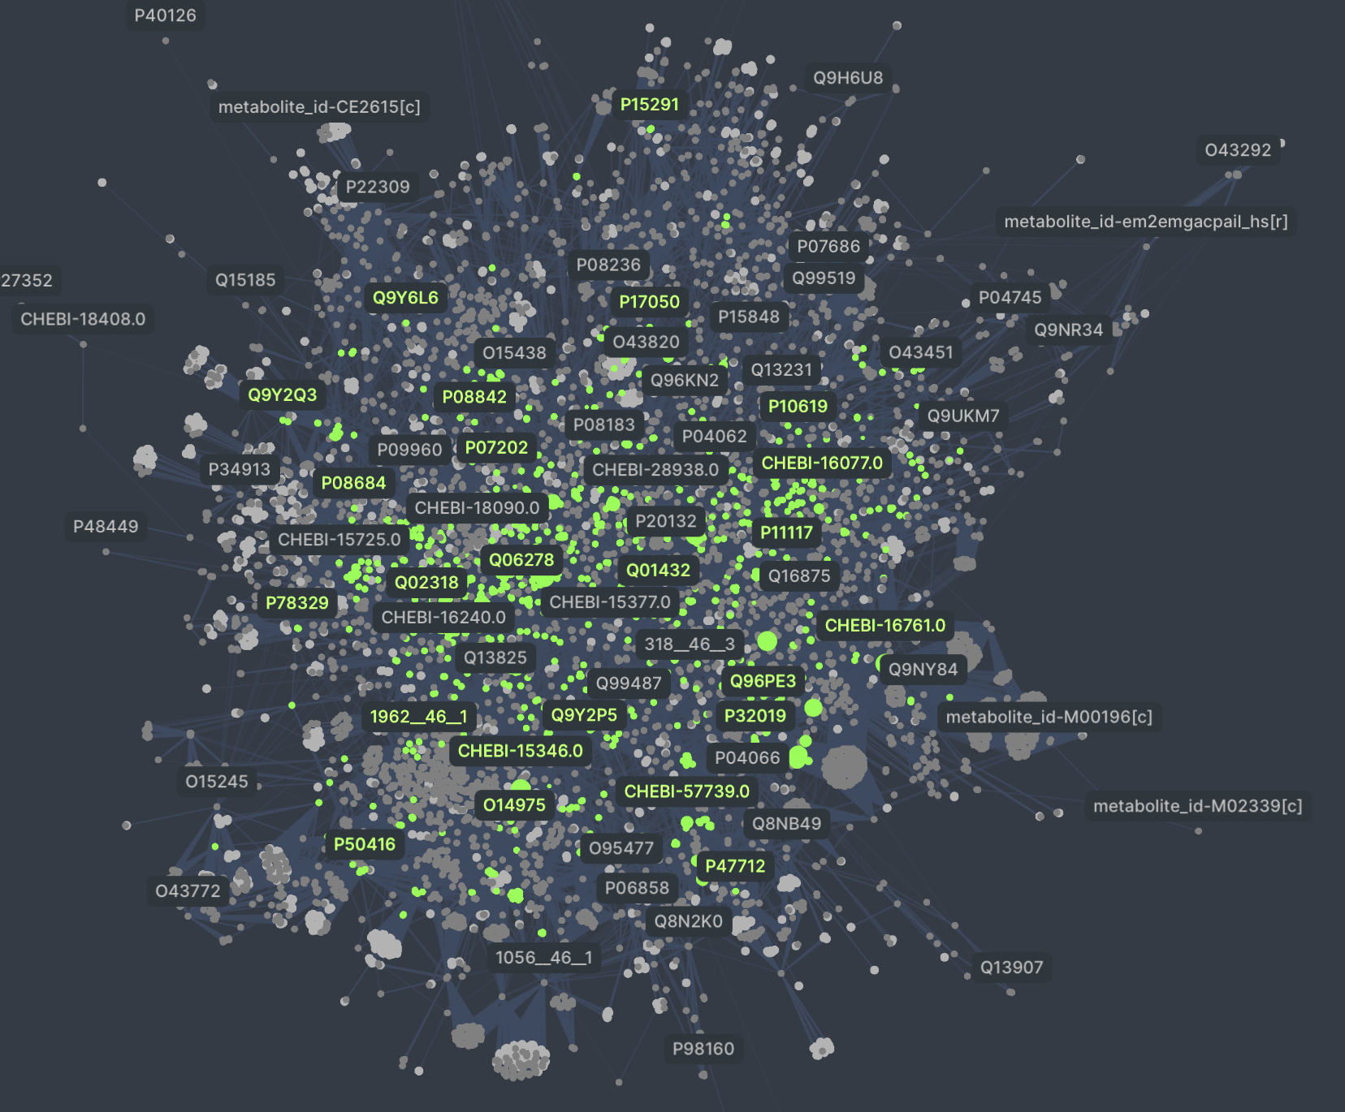
Predicting the effects of rare disease mutations on a system biology scale “virtual cell”
We have 3 goals
Compare system effects of rare disease mutations to create bigger cohorts of patients
Identify the 5,000 unknown patients who have CMT4J using biomarker analysis
Identify common pathways between existing drug targets and rare disease impact to repurpose drugs
01
02
03
Notes:
We utilize state-of-the-art machine learning models to predict changes that variants cause to the graph
First of its kind human genome scale protein-protein-metabolite-drug interaction knowledge graph

Slide 3





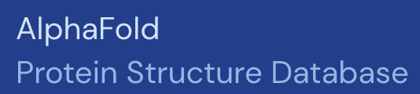


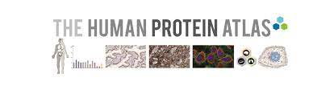


We combined 9 data sources and applied 3 different machine learning models over hundreds of proteins to build a “virtual cell”
Data Sources
Uniprot - Protein sequences and metadata
BioGrid - Protein-protein interactions
RHEA - Metabolic pathways
BRENDA - Metabolic pathways
ProteinAtlas - targets of FDA approved drugs
Chebi - Metabolite metadata
PubMed - Literature
Protein Data Bank (PDB) - Protein structures
AlphaFold Database - Predicted protein structures
Machine Learning Models
AlphaMissense (predictions)
Identifying pathogenic mutations
PeSTo
Predicted protein-protein and protein-ligand interactions sites
AlphaFold-Multimer
Predicted protein complex structures
AlphaFold-Multimer
AlphaMissense

Slide 4
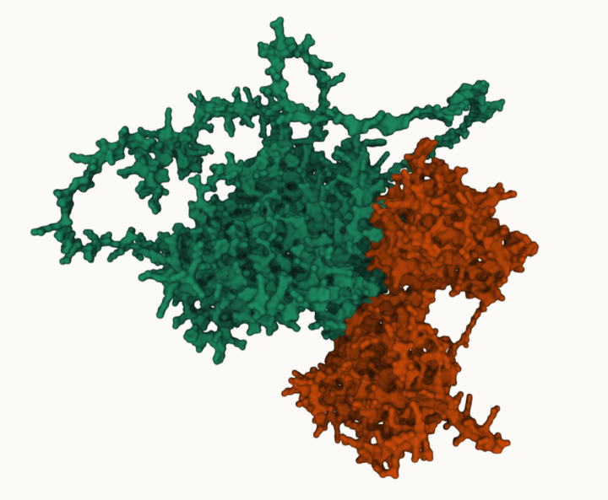
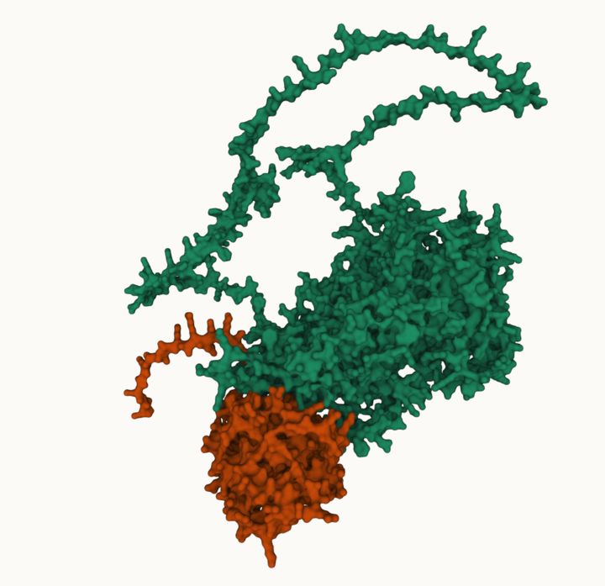
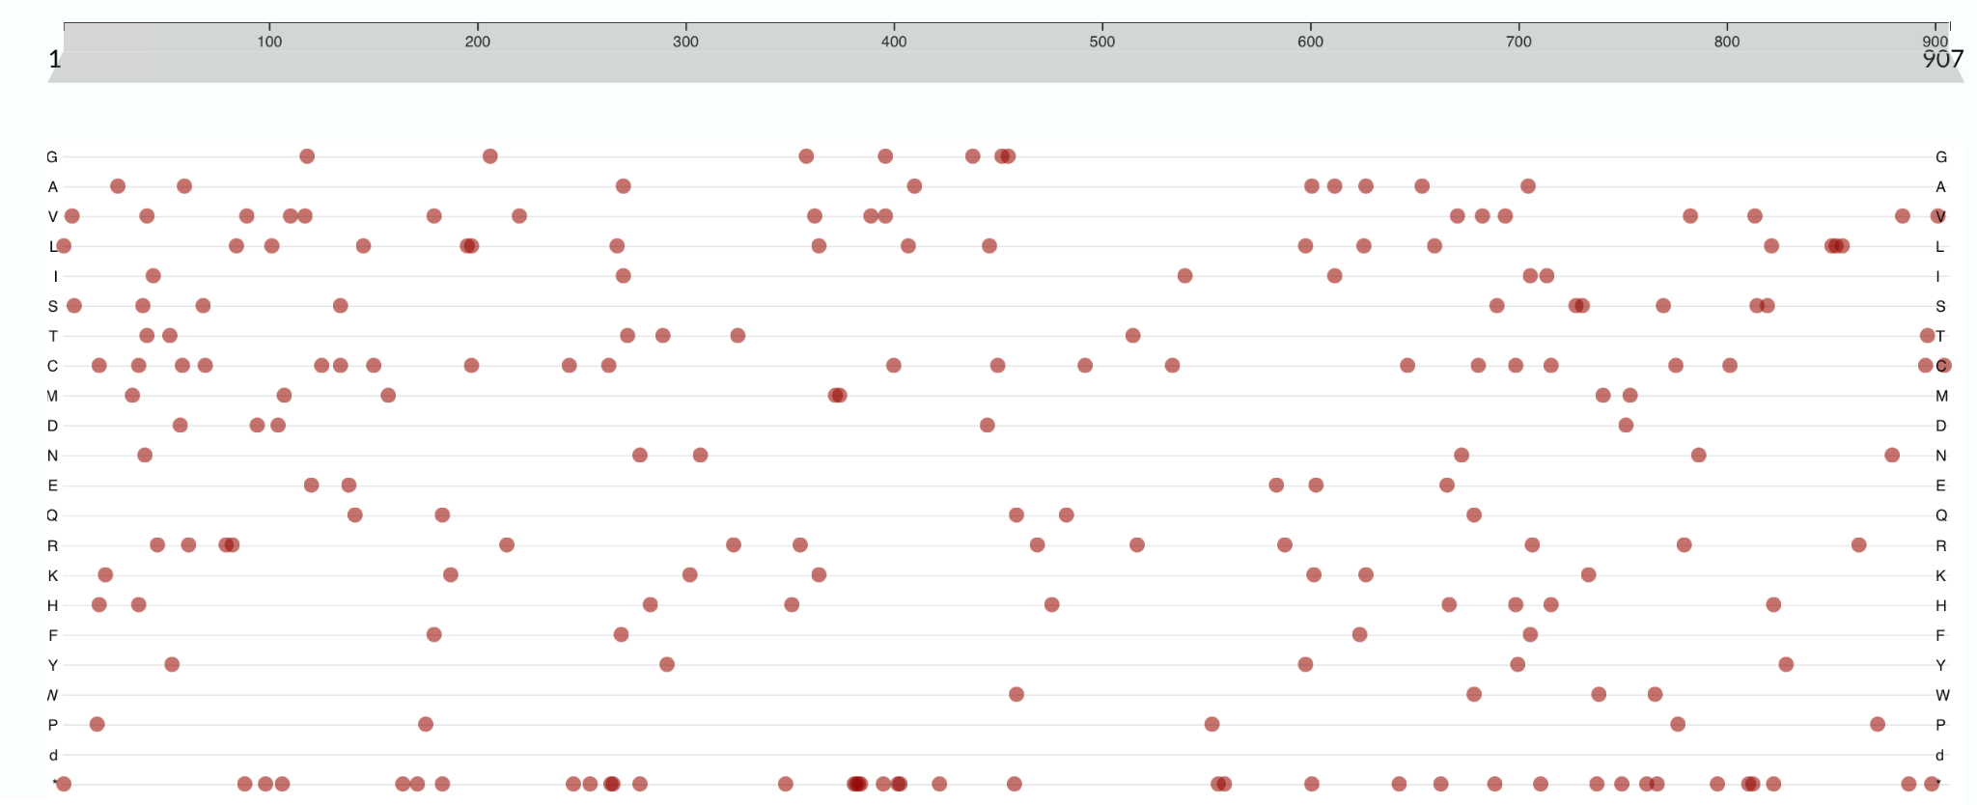
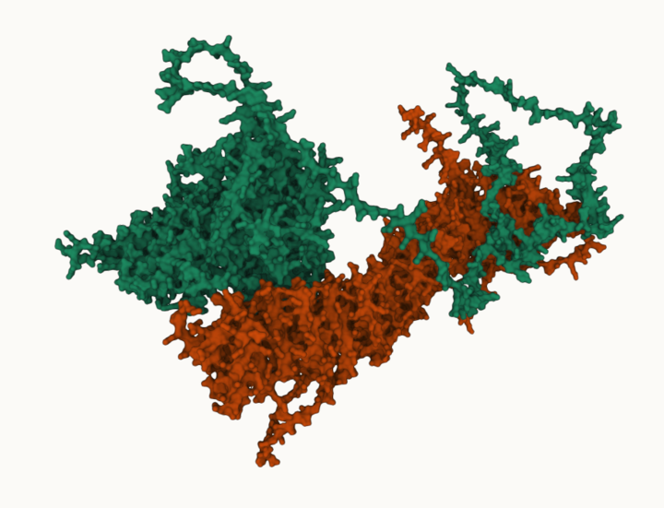
Method slide
Using interaction site models we predict “pathway impact score” from pathogenic mutations which inform changes on “virtual cell”
We select the nearest neighbors of our target gene - in this case the FIG4 gene
We predict the protein complex structure using AlphaFold-Multimer to predict whether known or predicted pathogenic variants lie on the protein-protein interaction interface and will impact protein-protein interactions (bioRxiv 2024.02.19.580970)
We predict the protein-ligand interfaces using PeSTo to identify whether known or predicted pathogenic variants lie on the protein-protein interaction interface and will impact enzymatic activity
We give an “impact score” depending on how close to an interface the variant is and apply these scores to the “virtual cell” interactions
SNX27
RAB7A
SNX27
VAC14
VAC14
+
SNX27
VAC14
RAB7A
VAC14

Slide 5
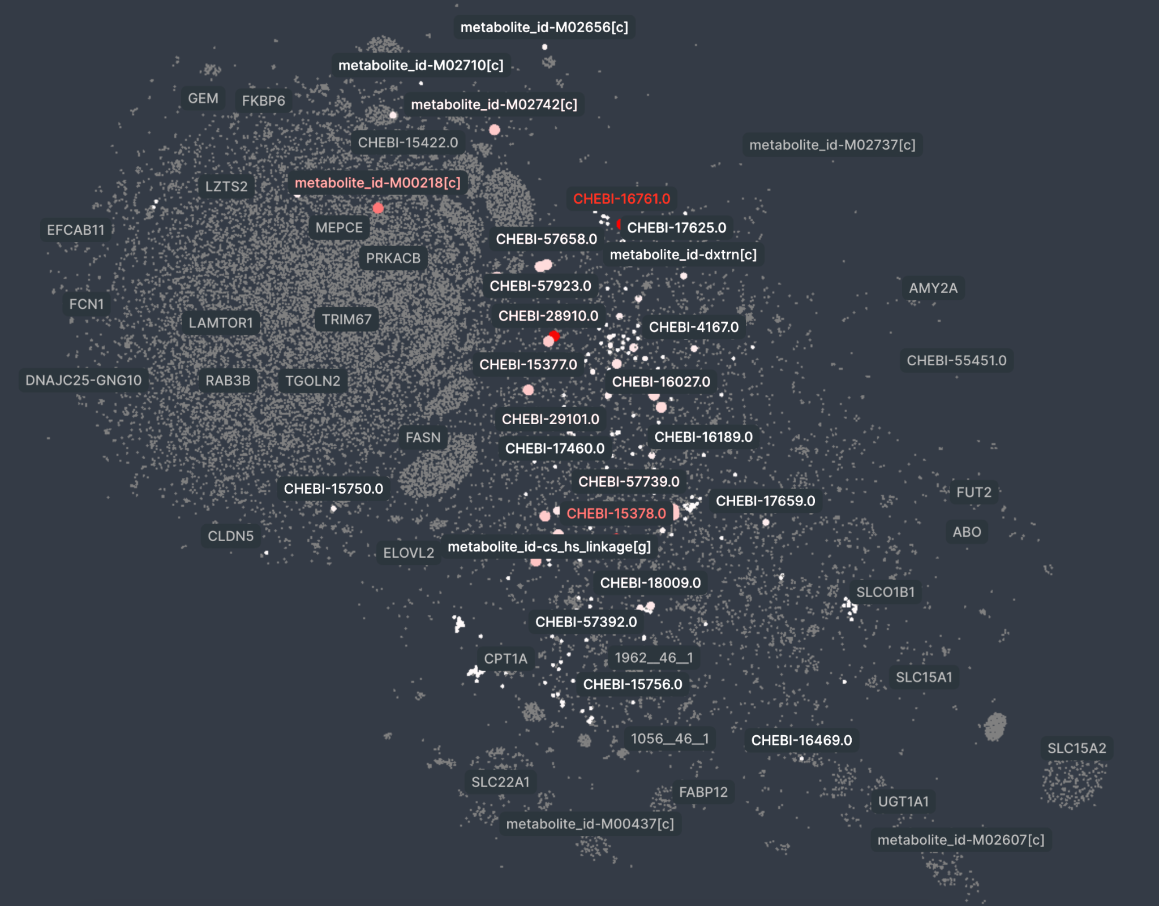
Results slide
Pathway and Biomarker Identification
– Excluded water and other very common molecules
(glutathione, 10.59)
(1-phosphatidyl-1D-myo-inositol 3,4-bisphosp(5-), 9.29)
(1-phosphatidyl-1D-myo-inositol 3,5-bisphosp(5-), 7.96)
(1-phosphatidyl-1D-myo-inositol 3,4,5-trisphosp(7-), 6.79)
(oxalic acid, 5.37)
(D-glucopyranose, 5.02)
('HC02053[c]', 4.59)
(2-oxoglutaric acid, 4.37)
(succinic acid, 4.34)
(1-phosphatidyl-1D-myo-inositol 4-phosphate(3-), 3.77)
(1-phosphatidyl-1D-myo-inositol 4,5-bisphosphate, 3.48)
(phosphatidate(2-), 3.28)
(1-phosphatidyl-1D-myo-inositol 5-phosphate(3-), 3.07)
('HC02052[c]', 2.87)
('HC02050[c]', 2.87)
('HC02086[c]', 2.87)
('HC02054[c]', 2.87)
('HC02051[c]', 2.87)
('HC02093[m]', 2.87)
(sulfate, 2.56)
(D-glucopyranose 6-phosphate, 2.31)
('pail5p_hs[g]', 1.44)
(D-glucopyranose 1-phosphate, 1.27)
('alpa_hs[c]', 1.26)
(thiosulfate(2-), 1.12)
(9H-xanthine, 0.87)
((S)-malic acid, 0.84)
(adenine, 0.76)
(uracil, 0.72)
(hypoxanthine, 0.7)
(guanine, 0.65)
(D-ribosylnicotinic acid, 0.62)
(2-deoxy-D-ribofuranose 1-phosphate, 0.58)
(alpha-D-ribose 1-phosphate, 0.52)
(nicotinamide, 0.45)
(sn-glycerol 3-phosphate, 0.42)
('ggn[c]', 0.4)
(thymine, 0.26)

Slide 6
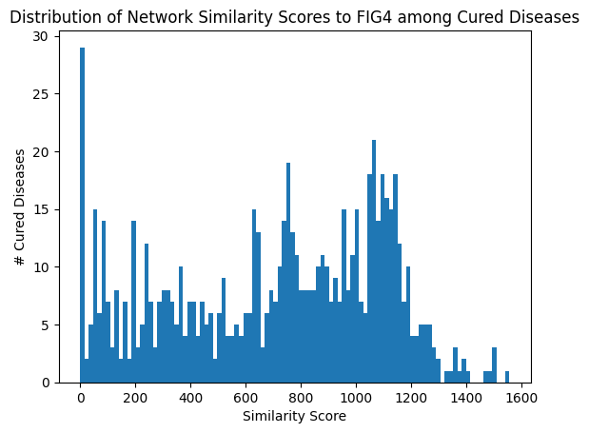
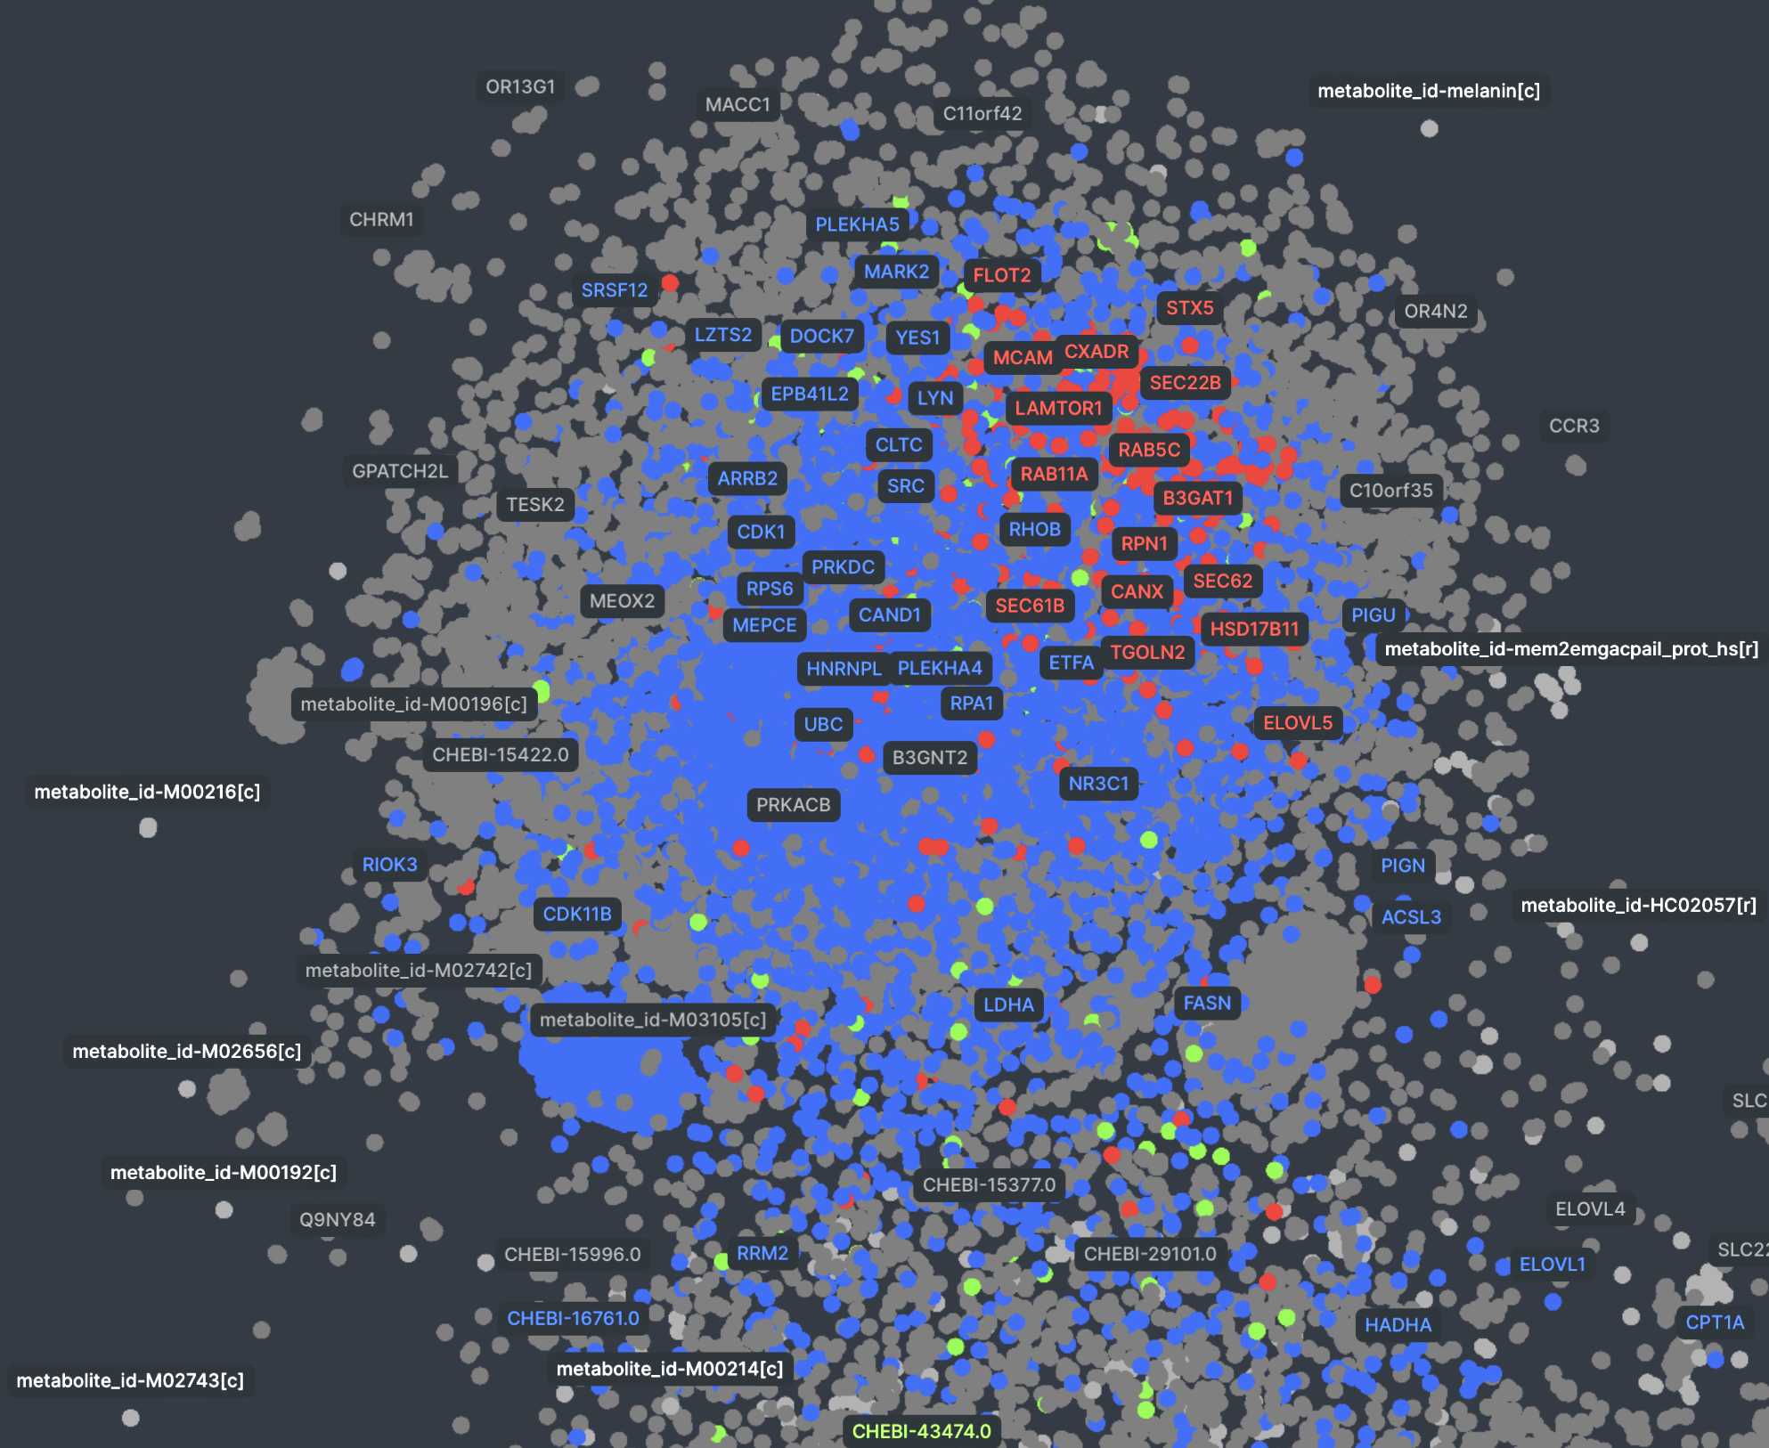
Discussion slide
Drug Repurposing
We calculate the pathway similarity between FIG4 and all other 854 cured diseases with the hope to find a combination of available drugs which could alleviate the symptoms of rare diseases
FIG 4 and 1A1COL

Slide 7
The future of creating a “virtual cell”
Over the hackathon we achieved
Our project attempts to solve a key challenge in rare disease research in which we have low data and wish to more easily diagnose patients who are not immediately sent to full-genome sequencing (via biomarkers) and then efficiently propose potential therapeutic targets.
We successfully created a first-of-its-kind “virtual cell” in which we can quickly use complex state-of-the-art machine learning methods to analyse the impacts of genetic mutations.
While we present a first shot on goal and extract new insights in just one weekend, we expect this project to expand and evolve given additional time.
Importance of future work in this space and associated challenges
In rare diseases we have extremely limited data about each disease and limited cohorts for both research and clinical trials
Building a system-level “virtual cell” can take advantage of vast amount of literature and experimental data to alleviate issues caused by lower data
The key challenges involve how to apply experimental data to understand the confidence we have in all of these interactions
Additionally we would like to be able to develop a method to compare between different diseases efficiently in-silico to build bigger cohorts of patients across diseases
We plan to host the tool on a live website soon. Please reach out on Slack for immediate access!
David Magrefty, Itamar Chinn, Ilan Mitnikov, Liyam Chitayat

Slide 8
